Slide 1
3rd SEMESTER
AUTOMATIC BATTERY CHARGER
~ ANALOG ELECTRONICS & LINEAR INTEGRATED CIRCUITS PROJECT ~
PROGRESS REPORT
SUBMITTED BY - GROUP 7
NAME | ENROLLMENT NO.
INDRANI CHAKRABORTY | 23UEI088
ANTARLINA DATTA | 23UEI092
DEBAJYOTI DEY | 23UEI094
ADITYA DEBNATH | 23UEI097
APURBA DAS | 23UEI098
AKARSH SAHAYA | 23UEI102

Slide 2
1
ABSTRACT
This project focuses on designing an automatic battery charger circuit for 12V and 6V batteries with a built-in current-limiting option to protect both the charger and battery from overcurrent scenarios. The charger automatically detects the battery's voltage level and adjusts the charging process accordingly, ensuring efficient and safe charging. The current-limiting feature prevents excessive current flow, safeguarding the battery from potential damage due to overcharging or overheating. The circuit is designed to support lead-acid and other rechargeable battery types, with emphasis on energy efficiency and protection. This solution is ideal for applications requiring reliable battery management for automotive, backup power systems, or other electronic devices.

Slide 3
2
COMPONENTS
SL.NO. | COMPONENT | SPECIFICATIONS | QUANTITY
1 | Transformer | 300mA, 230V -12V | 1
2 | Potentiometer | 10kΩ | 1
3 | Diodes | IN5408,IN4007 | 2
4 | Transistor | BC547 | 1
5 | Bridge Rectifier | — | 1
6 | Resistor | 10kΩ | 1
7 | Resistor | 1kΩ | 5
8 | Relay: | 12V | 1
19 | Capacitor | 1000µF/25V | 1
10 | Capacitor: | 10µF/25V | 1
11 | Screw Terminals | — | 3
12 | LEDs | Red, Blue | 2
13 | Perforated Board | — | 1
ESTIMATED COST: ₹460.00

Slide 4
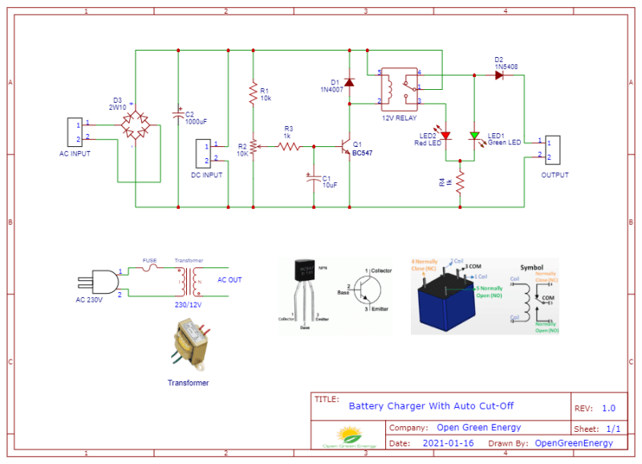
3
CIRCUIT DIAGRAM
FIG: CIRCUIT DIAGRAM FOR OUR AUTOMATIC
BATTERY CHARGER

Slide 5
4
Current Progress:
Detailed Circuit Design: The circuit design is complete and has been enhanced to include a more refined auto cutoff mechanism using BC547 transistors, relays, diodes, and a potentiometer. A focus has also been placed on integrating an adjustable current-limiting feature to prevent overcurrent conditions.
Key Elements:
BC547 Transistor: Controls the relay, triggering when the battery reaches full charge, disconnecting the charger.
Relay: Responsible for breaking the charging circuit, stopping further charging to prevent battery overcharging.
Diodes: Provide AC to DC rectification if needed and ensure reverse polarity protection.
Potentiometer: Allows the setting of the cutoff voltage, adjusted according to battery requirements, ensuring optimal charging conditions.

Slide 6
5
Current Limiting: The design now includes resistors and feedback circuits to regulate current flow, ensuring that the charging current does not exceed safe levels for the battery.
Charging Process Design:
Bulk Phase: The charger supplies a constant current until the battery reaches a specified voltage.
Absorption Phase: The voltage is held constant while the current gradually decreases.
Float Phase: The float phase maintains the battery at a lower voltage to keep it charged without overcharging.
Voltage Monitoring and Regulation: The circuit is equipped with continuous voltage sensing, which ensures that the battery voltage is closely monitored throughout the charging process. When the set voltage threshold is reached, the relay cuts off the circuit.
Current Limiting Circuit Implementation: The current limiting feature has been designed using a combination of resistors and transistors to automatically reduce the current flow once a predefined current threshold is reached. This protects both the battery and the charger from overcurrent scenarios.

Slide 7
6
Auto Cut-off Implementation: The auto cut-off feature has been refined to ensure a seamless transition from charging to float or complete cut-off mode. Once the battery reaches the target voltage, the transistor activates the relay to disconnect the charger.
Component Sourcing & Assembly:
Components Acquired: Key components such as BC547 transistors, relays, diodes, resistors, and potentiometers have been sourced.
Circuit Assembly: The assembly of the circuit has begun, focusing on proper wiring, component placement, and ensuring the current path is efficient and well-regulated.
Initial Testing Phase: Preliminary tests have been carried out on the 12V battery:
The bulk charging phase successfully charged the battery to the desired voltage.
The auto cut-off worked as expected, disconnecting the charger once the battery reached the full charge level.
Current limiting was also effective, preventing overcurrent during the charging process.
Adjustments are being made to fine-tune the cutoff and current-limiting features for the 6V battery as well.

Slide 8
7
Conclusion
The project is progressing significantly, with the core circuit design completed and initial testing yielding positive results. Adjustments and refinements are in progress to ensure stability and accuracy across different battery types. Current limiting and auto cut-off features are functioning, and further optimization is being carried out for efficiency and reliability.

